Slide 1
Social Data Institute
Continuing Professional Development (CPD) course
Introduction To Bayesian Inference & Modelling (June 2025)
Day 2: Introduction to Bayesian INFERENCE
Dr Anwar Musah (a.musah@ucl.ac.uk)
Lecturer in Social and Geographic Data Science
UCL Geography
Additional details:
https://www.ucl.ac.uk/social-data
1

Slide 2
Social Data Institute
Contents
Problem
Describe the overall workflow of Bayesian Inference
How does the Bayes’ Rule work
Data input, process model and assumptions
Types of priors
Derivation of the joint posterior distribution
Brief examples of conjugate and non-conjugate posterior
Knowledge
Collect
Model
Wrangle
Explore
2

Slide 3


Quick recap
Definition:
Bayesian statistics, is all about uncertainty (i.e., lack of complete sureness or knowledge). It is essentially the practice of expressing what you believe about something as a probability (before observing that thing); and then using new evidence (after observing that thing) to update those beliefs thereafter.
Basic Probabilities
Probability Distribution
Bayes’ Theorem
Bayesian Inference
3

Slide 4
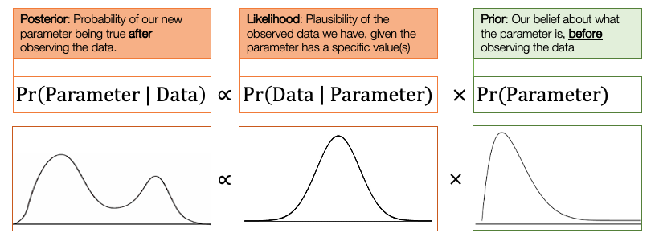


Quick recap
This equation is the backbone of Bayesian Statistics
Basic Probabilities
Probability Distribution
Bayes’ Rule
Bayesian Inference
4

Slide 5
Bayesian Inference
5

Slide 6
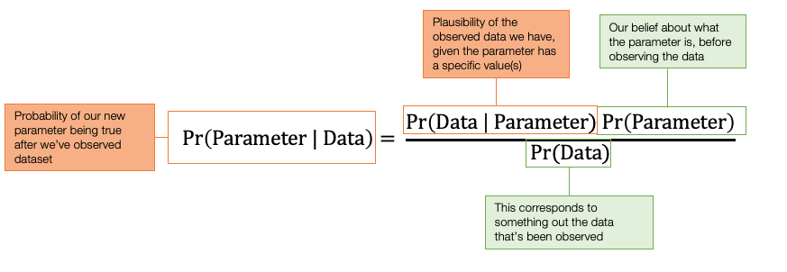
Definition:
Bayesian inference uses the Bayes’ Theorem to update what we believe about something (i.e., parameters) as we get new information (i.e., data). It's a way to learn and improve our understanding using both prior knowledge and new information.
Posterior
Likelihood
Prior
This is what is derived:
Posterior probability $∝$ Likelihood x Prior Probability
This equation is the backbone of Bayesian Statistics
6
Notes:
Bayes' Theorem updates what we believe about a parameter (or hypothesis) after seeing data. It combines:
What we believed before (the prior)
How well the data fits different values of the parameter (the likelihood)
Into what we now believe after seeing the data (the posterior)

Slide 7
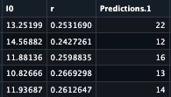

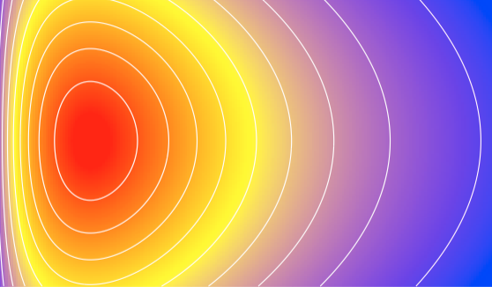




Workflow for Bayesian Inference
Inputs
Observed data
Process model for likelihood (statistical or mechanistic model)
Building our priors i.e., assumptions about the parameters
Output
Summary table (mean, percentile and credibility intervals)
Predictions made from generated quantities block
Task 1:
Model Building
Task 3:
Simulation the quantities of interest
Building the Posterior Distribution
Sampled Posterior
Task 2:
Equation Sampling
r
$$⋮$$
$$⋮$$
$$⋮$$
I₀
Sample results for parameters
Samples for the predictions
7
Notes:
When we are doing Bayesian inference – based on this Bayes Rule – every project has the following work flow:
1. We start with an input step where we gather our data and assumptions

Slide 8
Inputs
Observed data
Process model for likelihood (statistical or mechanistic model)
Building our priors i.e., assumptions about the parameters
Output
Summary table (mean, percentile and credibility intervals)
Predictions made from generated quantities block
Task 1:
Model Building
Task 3:
Simulation the quantities of interest
Full Posterior
Sampled Posterior
Task 2:
Equation Sampling
r
$$⋮$$
$$⋮$$
$$⋮$$
I₀
Sample results for parameters
Samples for the predictions
8
Notes:
When we are doing Bayesian inference – based on this Bayes Rule – every project has the following work flow:
1. We start with an input step where we gather our data and assumptions

Slide 9
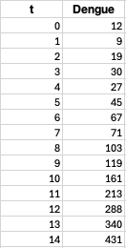
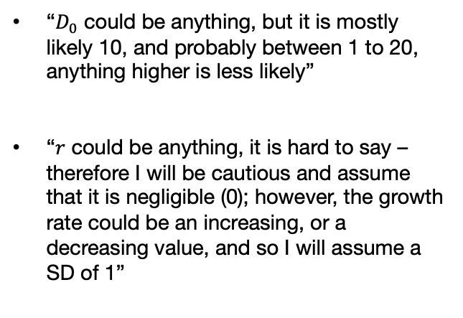
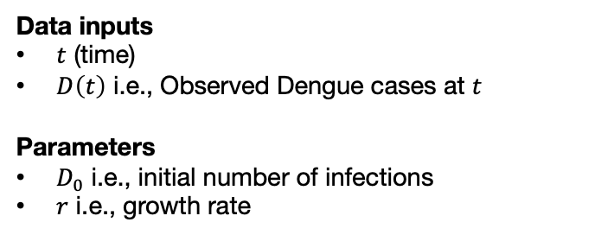

Inputs: Data, process model and assumptions [1]
Bayesian estimation of Epidemic Growth for Aedes-borne Infections
During the early days of heavy rainfall - there is a huge influx of mosquito populations in Recife which causes an outbreak Dengue virus. Public health officials collected daily case counts over the course of 15 days during this period where rainfalls are pronounced.
Data
Process Model
Prior Assumptions
$$D\left(t\right)=D_{0}{×e}^{r×t}$$
Data inputs
$t$ (time)
$D\left(t\right)$ i.e., Observed Dengue cases at $t$
Parameters
$D_{0}$ i.e., initial number of infections
$r$ i.e., growth rate
“$D_{0}$ could be anything, but it is mostly likely 10, and probably between 1 to 20, anything higher is less likely”
“$r$ could be anything, it is hard to say – therefore I will be cautious and assume that it is negligible (0); however, the growth rate could be an increasing, or a decreasing value, and so I will assume a SD of 1”
9
Notes:
t and number of dengue cases
Process model is always a function of the data, and parameters we intend to estimate

Slide 10
Inputs: Data, process model and assumptions [2]
Broad types of priors
Informative Priors:
These are priors that express specific and definite knowledge about the parameter we are type to estimate. These incorporate strong (and confident) beliefs that reflect existing knowledge or expert opinion.
These parameter ranges are assigned to higher plausibility in the spectrum in the probability’s distribution spectrum
Weakly Informative Priors:
These are priors that express some reasonable knowledge about the parameter. These incorporate modest (and not overly confident) beliefs.
Uninformative (Non-informative) Priors:
These are priors that express a lack of belief or knowledge about the parameter(s) in question. What often happens here are:
We assign uniform priors where it is assumed that all parameter values are equally likely
We use the default settings of the software – which decides the which priors to use.
Not knowing the direction of the relationship for coefficients (i.e., increasing or decreasing) or taking a neutral stance can be fall into this category of being uninformative.
10
Notes:
Priors are classified based on the strength and nature of the information they incorporate.

Slide 11
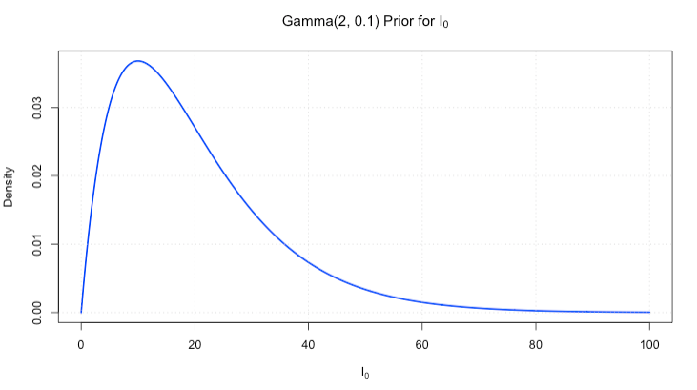
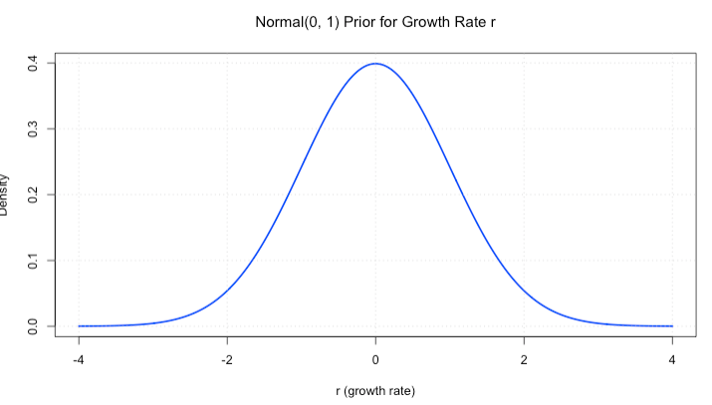
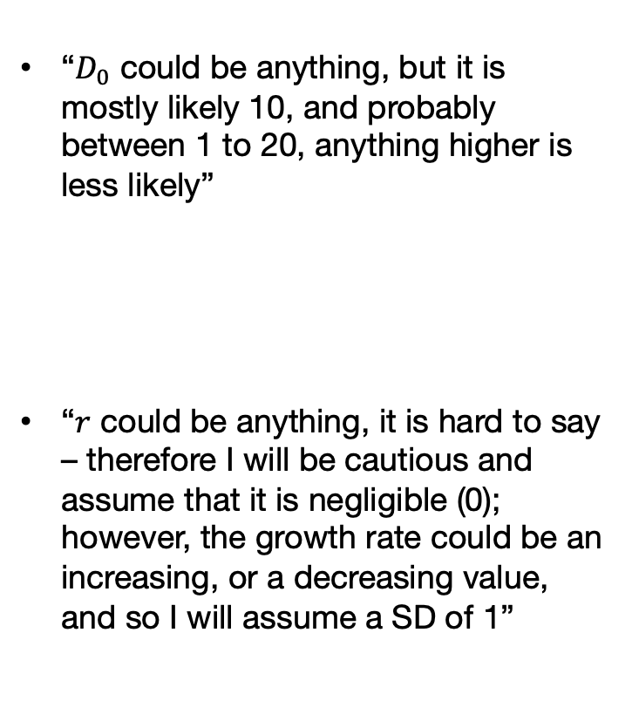
Inputs: Data, process model and assumptions [3]
Assumptions
Probability Distribution
Prior type
“$D_{0}$ could be anything, but it is mostly likely 10, and probably between 1 to 20, anything higher is less likely”
“$r$ could be anything, it is hard to say – therefore I will be cautious and assume that it is negligible (0); however, the growth rate could be an increasing, or a decreasing value, and so I will assume a SD of 1”
gamma(2, 0.1)
Weakly-Informative prior
normal(0, 1)
Non-Informative prior
11

Slide 12
Inputs
Observed data
Process model for likelihood (statistical or mechanistic model)
Building our priors i.e., assumptions about the parameters
Output
Summary table (mean, percentile and credibility intervals)
Predictions made from generated quantities block
Task 1:
Model Building
Task 3:
Simulation the quantities of interest
Full Posterior
Sampled Posterior
Task 2:
Equation Sampling
r
$$⋮$$
$$⋮$$
$$⋮$$
I₀
Sample results for parameters
Samples for the predictions
12
Notes:
Now let’s turn our attention to generating the full posterior distribution

Slide 13
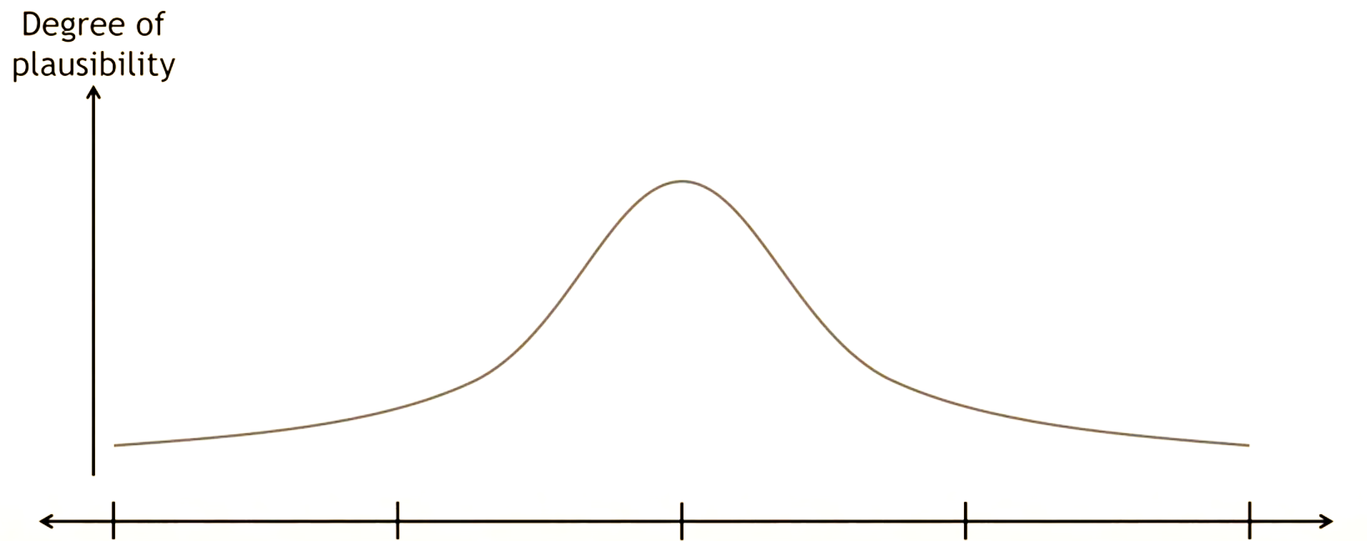


Building the Posterior Distribution [1]
Let us take epidemic growth r parameter as an
example, we say we are estimating “r” parameter
that is consistent with the data – we are not referring to a single number of a fixed value. We are referring a whole range of them that is consistent with the data.
The range of values with that have highly plausible than others simply mean that they’re more consistent with the data compare to other parameters whose plausibility's are lower.
$$Pr⁡(r|Data)$$
-2
-1
0
1
2
$$r$$
13

Slide 14
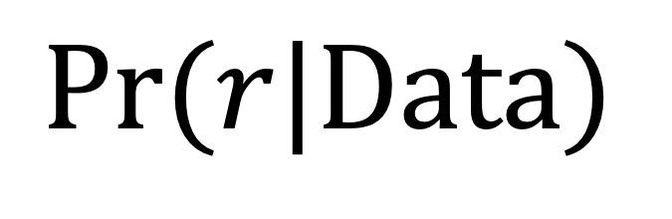
Building the Posterior Distribution [2]
After learning from, or conditional on this
specific dataset.
Posterior is based on a single parameter
$$Pr⁡(r|Data)$$
The variable (or indicator) that we are describing
the plausibility about. In this case, epidemic growth
rate for Dengue.
14

Slide 15
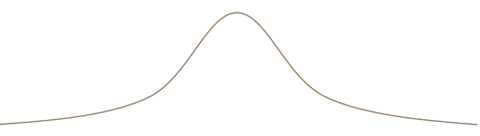



Building the Posterior Distribution [3]
$$Pr⁡(r|{Data}_{1})$$
$$Pr⁡(r|{Data}_{0})$$
$$Pr⁡(r|{Data}_{2})$$
-2
-1
0
1
2
15

Slide 16
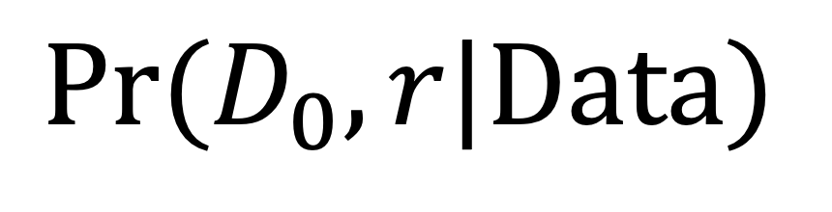
Building the Posterior Distribution [4]
After learning from, or conditional on this
specific dataset.
Posterior can be based on a multiple parameters.
This is called a joint posterior distribution.
$$Pr⁡(D_{0}, r|Data)$$
This describes the plausibility of a combination
of parameters jointly based on the data that was
given. In this case, epidemic growth and initial case counts.
16
Notes:
Let visualise a two parameter…

Slide 17
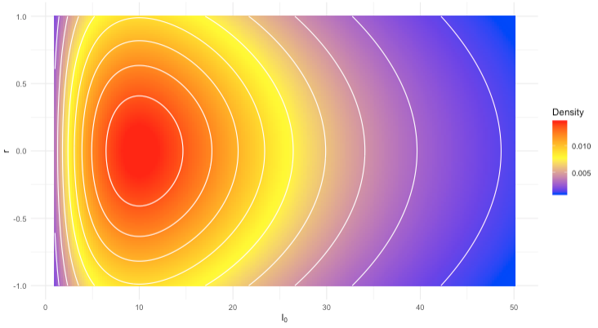



Building the Posterior Distribution [5]
$$Pr⁡(D_{0}, r|Data)$$
High
Plausibility
All plausibility level are between 0 and 1
Volume under the surface is sums to 1
Different data will change the shape of this structure
$$r$$
Low
Plausibility
$$D_{0}$$
How is this posterior distribution generated?
17

Slide 18



















Data
Likelihood:
$$Poisson({D_{t} | D}_{0}{×e}^{r×t})$$
$$Poisson({12 | D}_{0}{×e}^{r×0})$$
$$Poisson({9 | D}_{0}{×e}^{r×1})$$
$$Poisson({19 | D}_{0}{×e}^{r×2})$$
$$Poisson({30 | D}_{0}{×e}^{r×3})$$
$$Poisson({27 | D}_{0}{×e}^{r×4})$$
$$Poisson({45 | D}_{0}{×e}^{r×5})$$
$$Poisson({67 | D}_{0}{×e}^{r×6})$$
$$Poisson({71 | D}_{0}{×e}^{r×7})$$
$$Poisson({103 | D}_{0}{×e}^{r×8})$$
$D_{0}$ ~ gamma(2, 0.1)
r ~ normal(0, 1)
$$Poisson({119 | D}_{0}{×e}^{r×9})$$
$$Poisson({161 | D}_{0}{×e}^{r×10})$$
$${Pr⁡(D}_{0})$$
$$Pr⁡(r)$$
$$Poisson({213 | D}_{0}{×e}^{r×11})$$
$$Poisson({288 | D}_{0}{×e}^{r×12})$$
Prior distribution built from set of assumption
$$Poisson({340 | D}_{0}{×e}^{r×13})$$
$$Poisson({431 | D}_{0}{×e}^{r×14})$$
The process model is what we build as the likelihood function. For each data point we observed, we find its likelihood function and multiply them all together
18

Slide 19








Likelihood function
Priors
Posterior $∝$
$$Poisson({12 | D}_{0}{×e}^{r×0})×$$
$$Poisson({9 | D}_{0}{×e}^{r×1})×…×$$
$$Poisson({431 | D}_{0}{×e}^{r×14})$$
$×$gamma($D_{0}$; 2, 0.1) $×$
normal(r; 0, 1)
$$Pr⁡(D_{0}, r|Data)$$
High
Plausibility
$$r$$
This example is a
non-conjugate posterior. This is a result formed by combining different types of probability distributions together to form a custom distribution.
Low
Plausibility
$$D_{0}$$
19
Notes:
binomial with beta – posterior in a form of beta
poisson with gamma – posterior forms a gamma
norm with norm – forms a normal

Slide 20
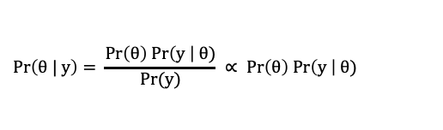
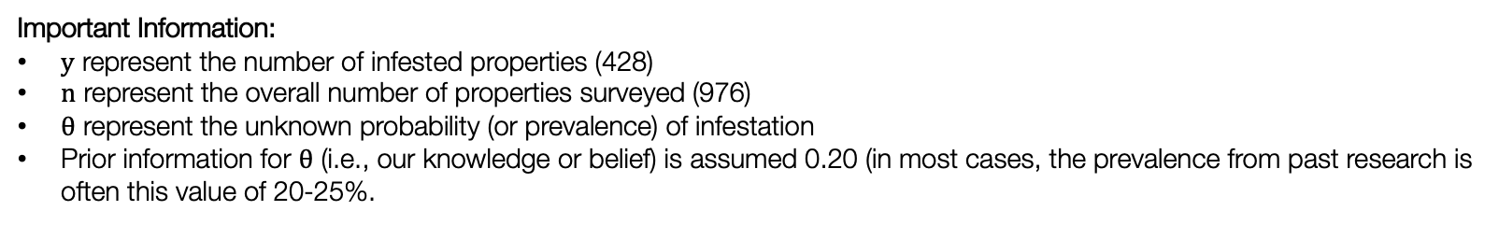
Social Data Institute
Motivating example [1]:
$$Pr\left(θ | y\right)= \frac{Pr\left(θ\right) Pr\left(y \right| θ)}{Pr⁡(y)} ∝ Pr\left(θ\right) Pr\left(y \right| θ)$$
What is the probability (or prevalence) of infestation in Recife this year?
Survey year: 05/2023 | Number properties detected with Aedes | Overall number of properties surveyed
* Most recent data collection effort. | 428 | 976
Important Information:
$y$ represent the number of infested properties (428)
$n$ represent the overall number of properties surveyed (976)
$θ$ represent the unknown probability (or prevalence) of infestation
Prior information for $θ$ (i.e., our knowledge or belief) is assumed 0.20 (in most cases, the prevalence from past research is often this value of 20-25%.
Likelihood function: $P\left(y \right| θ)$ = $\left({n \atop y}\right)θ^{y}{(1−θ)}^{n−y}$
Alternatively, instead type this mathematical notation, you use this statistical notation: $y \sim Bin(n, θ)$
We have specified the probability function for the likelihood, what about the function for the prior i.e., $P(θ)$?
20

Slide 21
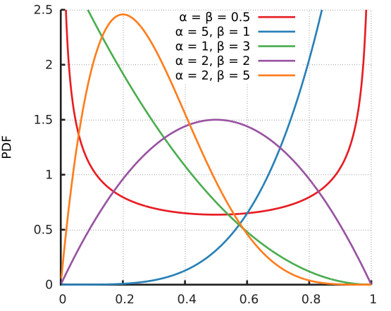

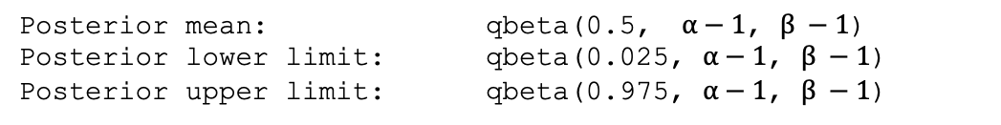
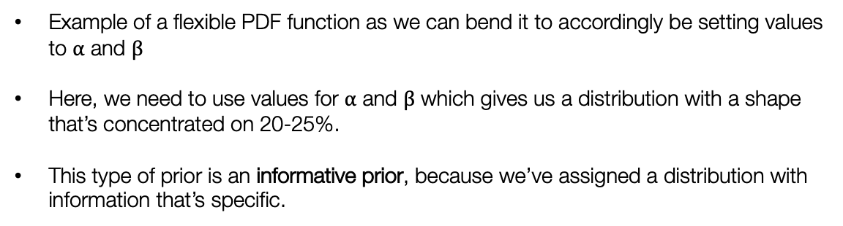
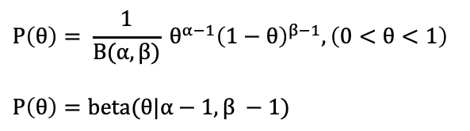
Social Data Institute
dbeta(prop, $α−1$, $β −1$)
pbeta(prop, $α−1$, $β −1$)
Motivating example [2]:
The probability distribution needed in this situation is a Beta distribution. It is the best probability function to use a prior distribution for unknown parameter that’s a proportion.
$$P\left(θ\right)= \frac{1}{B(α,β)} θ^{α−1}{\left(1−θ\right)}^{β−1}, \left(0<θ<1\right)$$
$$P\left(θ\right)=beta(θ|α−1, β −1)$$
Posterior mean: qbeta(0.5, $α−1$, $β −1$)
Posterior lower limit: qbeta(0.025, $α−1$, $β −1$)
Posterior upper limit: qbeta(0.975, $α−1$, $β −1$)
Example of a flexible PDF function as we can bend it to accordingly be setting values to $α$ and $β$
Here, we need to use values for $α$ and $β$ which gives us a distribution with a shape that’s concentrated on 20-25%.
This type of prior is an informative prior, because we’ve assigned a distribution with information that’s specific.
21
Notes:
B(alpha, beta) is a normalisation constant term. It controls the way the curve looks.

Slide 22
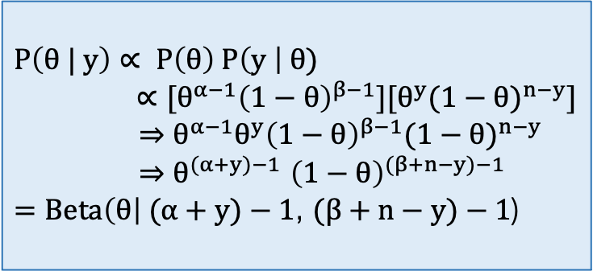

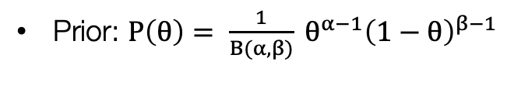
Solutions [1]:
Likelihood function: $P\left(y \right| θ)$ = $\left({n \atop y}\right)θ^{y}{(1−θ)}^{n−y}$
Prior: $P\left(θ\right)= \frac{1}{B(α,β)} θ^{α−1}{\left(1−θ\right)}^{β−1}$
For a binomial model specification, with Beta prior, the posterior is:
$$P\left(θ | y\right)∝ P\left(θ\right) P\left(y \right| θ)$$
$∝[θ^{α−1}{\left(1−θ\right)}^{β−1}][θ^{y}{(1−θ)}^{n−y}]$
$⇒θ^{α−1}{θ^{y}\left(1−θ\right)}^{β−1}{(1−θ)}^{n−y}$
${⇒θ}^{(α+y)−1}{\left(1−θ\right)}^{(β+n−y)−1}$
$=Beta\left(θ\right| (α+y)−1$, $(β+n−y)−1$)
All constants with the parameter of interest can be removed i.e., $\left({n \atop y}\right)$ and $\frac{1}{B(α,β)}$
Arranging like terms so $θ$’s and $(1−θ)$’s together
Using indices $a^{m}a^{n}=a^{m+n}$
As you can see the posterior distribution is a Beta distribution, but the parameters for it have been updated.
When the posterior is in the same family as the prior, we say the prior is a conjugate for the model.
Here, the Beta prior is a conjugate for the binomial model.
22
Notes:
Remember all

Slide 23
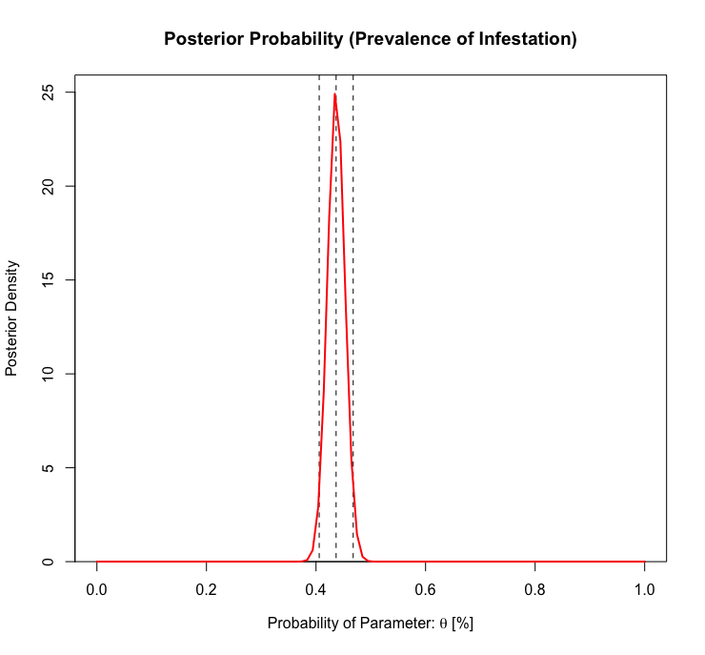
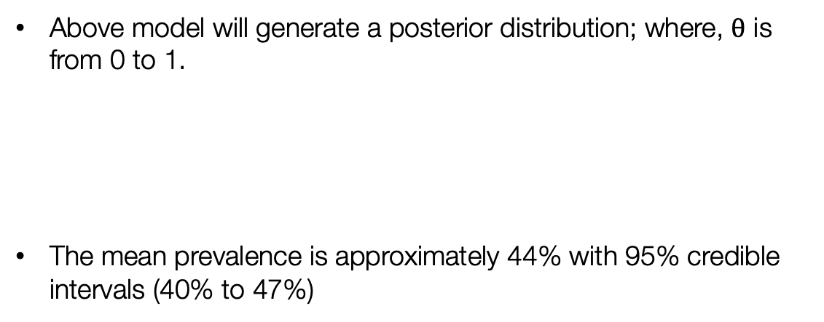
Social Data Institute
Solutions [2]:
$$\text{Updated} \text{Bayesian} \text{model}: P(θ|Y){ ∝ θ}^{(α+y)−1}{\left(1−θ\right)}^{(β+n−y)−1}$$
Combining this with infestation data, the posterior is $Beta\left(θ\right| (α+y)−1$, $(β+n−y)−1$)
Using an informative prior in this situation, where $α$ = 1 and $β$ = 5, we get the following
$Beta\left(θ\right| (1+428)−1$, ($5+976−428)−1$)
Above model will generate a posterior distribution; where, $θ$ is from 0 to 1.
The mean prevalence is approximately 44% with 95% credible intervals (40% to 47%)
Posterior mean: qbeta(0.5, $(1+428−1$, $(5+976−428) −1$)
Posterior lower limit: qbeta(0.025, $(1+428−1$, $(5+976−428) −1$)
Posterior upper limit: qbeta(0.975, $(1+428−1$, $(5+976−428) −1$)
23

Slide 24








Sampling the quantities of interest [1]
We use various algorithms
to generate a posterior
sample from the full joint
distribution so that its
manageable.
Markov Chains Monte Carlo
No U-turn
Hamiltonian Monte Carlo
$$Pr⁡(D_{0}, r|Data)$$
Start
High
Plausibility
The patterns of sampling should be like this illustration shown with the black lines. Where it is moving everywhere in an even manner. Otherwise, if the sampling is cluster in a particular region like the red lines – then it is biased leading divergent samples.
$$r$$
Stop
Low
Plausibility
$$D_{0}$$
24

Slide 25

Any questions?
25

